Slide 1
Learning with Augmented Reality
Team Member(s): Maryam & Maria Product Owner(s): Shahin Vassigh, Francisco Ortega, Lukas Borges
Instructor: Masoud Sadjadi School of Computing and Information Sciences Florida International University
Final Presentation
<Fall 2016>
Learning with AR
Notes:
7 seconds.
Greet your audience, thank them for attending your presentation, introduce yourself, introduce your project, introduce your team members, and quickly indicate what each of you did in a high-level manner, and put more emphasis on your part/contribution.

Slide 2
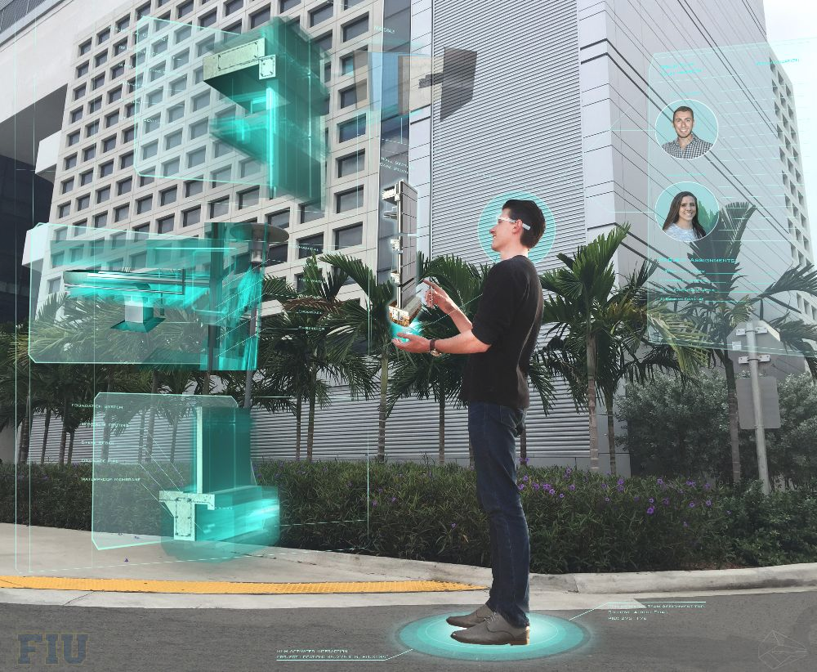
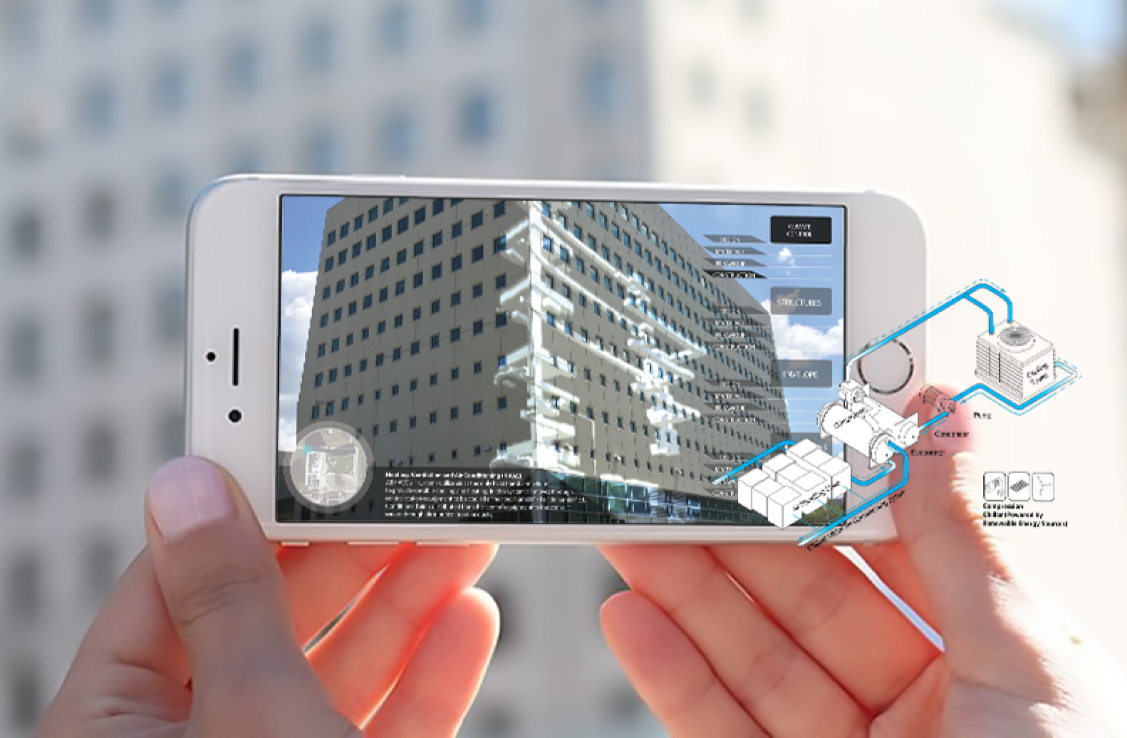
Project definition
Notes:
10 seconds.
Introduce the problem that the whole project (in all versions) tackles with GIF or screenshot.

Slide 3
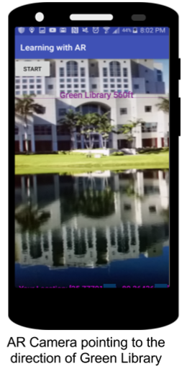
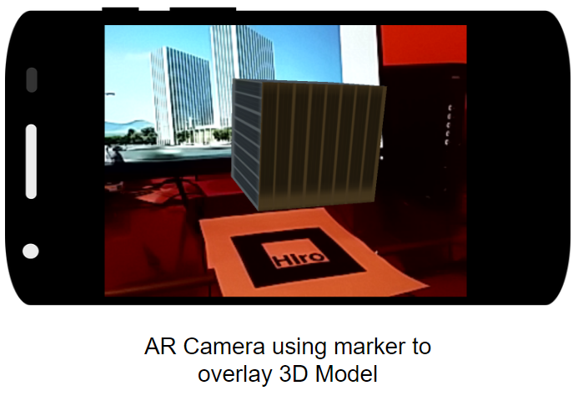
Project definition
Notes:
20 seconds.
Introduce the problem that the your project (in new version) tackles with GIF or screenshot.

Slide 4
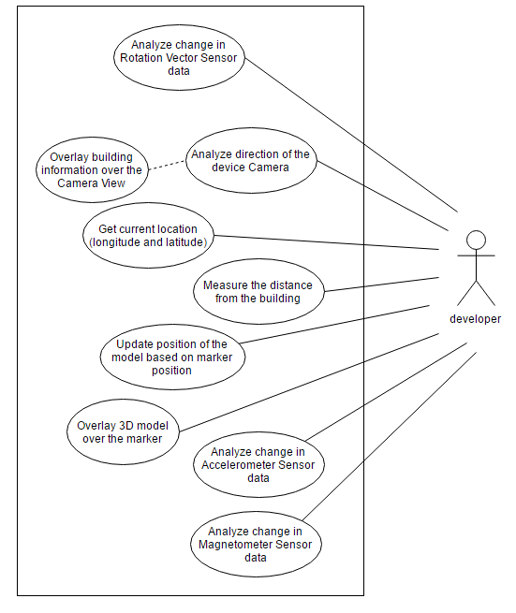
Requirements: Use Cases
Notes:
5 seconds
Show the Use Case Diagram for the whole project. Highlight your use cases.

Slide 5
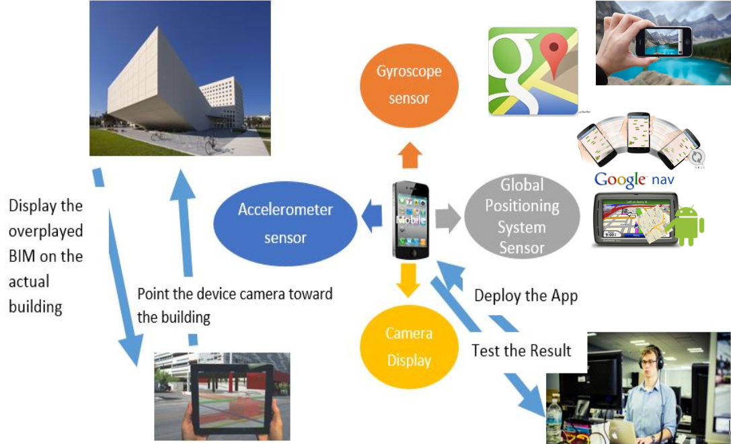
System Design: Architecture
Notes:
20 seconds
System design: Highlight the parts that you contributed to them.
1. System decomposition; identify the architecture patterns used
2. System deployment – h/w and s/w requirements

Slide 6
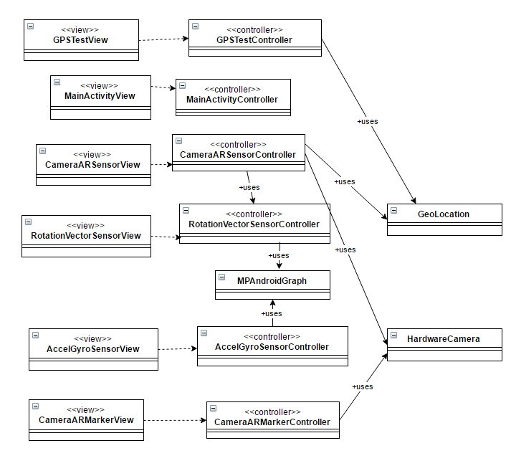
Minimal Class Diagram
Notes:
10 seconds.Minimal class diagram. Highlight the classes that you created/modified
Identify the design patterns used (one or more slides).

Slide 7
User Stories
1. #97 Analyze phone sensor data
2. #128 Getting GPS coordinates using Google API
3. #155 Use the phone to map direction of the building
4. #162 Integrate Image Processing Module
5. #166 Integration - GPS, Accelerometer and Gyroscope Graph and Unity AR Camera
Notes:
5 seconds.
List the user stories that you worked on them.(put in order of importance). Stay focused on the parts that you have been working.

Slide 8
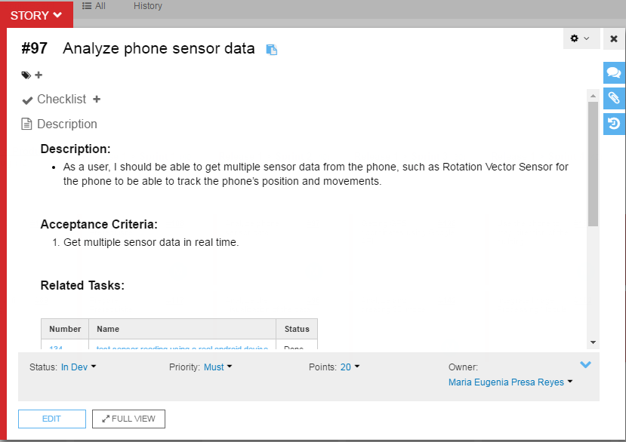
User Story #1
Notes:
60 seconds
The tile of user story
The most important user story you worked on it. You have to describe this one very well and be proud of that.
Please present and show the complexity of your work, code, algorithms, and technical challenges and technologies you have used. (you could use screenshot if you want. Visual presentations are better than text presentation)
Go into the details of the most important/significant tasks using bullet lists or visual graphs or state chart diagram
Sequence Diagram for this user story is mandatory (in another separate page if required)
Demo using screenshots or GIF (in another separate page if required)

Slide 9
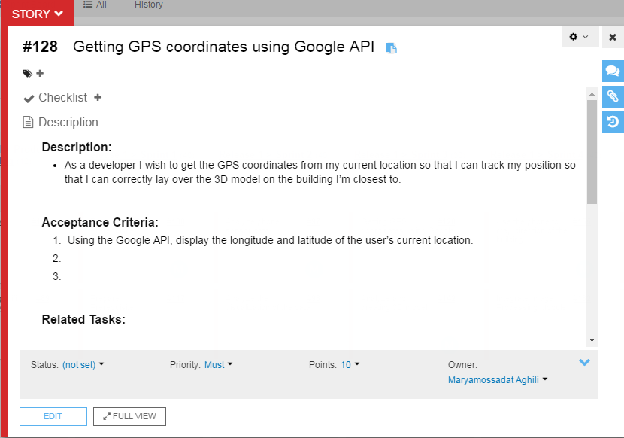
User Story #2
Notes:
20 seconds
The tile of user story
Please present and show the complexity of your work, code, algorithms, and technical challenges and technologies you have used. (you could use screenshot if you want. Visual presentations are better than text presentation) - Go into the details of the most important/significant tasks using bullet lists or visual graphs or state chart diagram - Demo using screenshots or GIF (in another separate page if required)
Sequence Diagram for this user story is optional

Slide 10
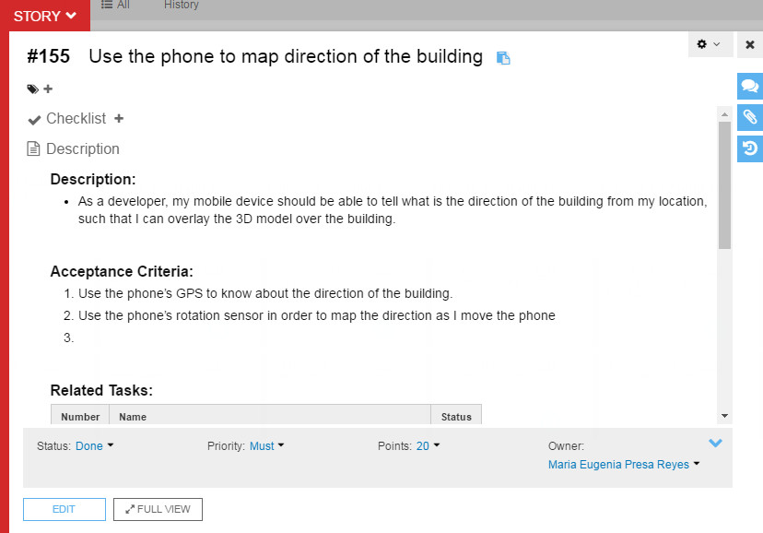
User Story #3
Notes:
20 seconds
The tile of user story
Please present and show the complexity of your work, code, algorithms, and technical challenges and technologies you have used. (you could use screenshot if you want. Visual presentations are better than text presentation) - Go into the details of the most important/significant tasks using bullet lists or visual graphs or state chart diagram - Demo using screenshots or GIF (in another separate page if required)
Sequence Diagram for this user story is optional

Slide 11
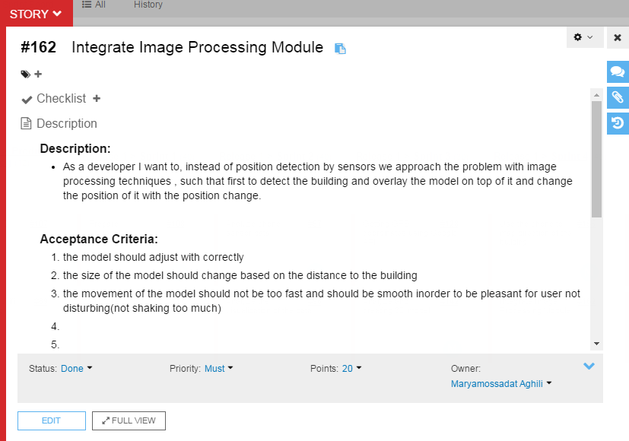
User Story #4
Notes:
20 seconds
The tile of user story
Please present and show the complexity of your work, code, algorithms, and technical challenges and technologies you have used. (you could use screenshot if you want. Visual presentations are better than text presentation) - Go into the details of the most important/significant tasks using bullet lists or visual graphs or state chart diagram - Demo using screenshots or GIF (in another separate page if required)
Sequence Diagram for this user story is optional

Slide 12
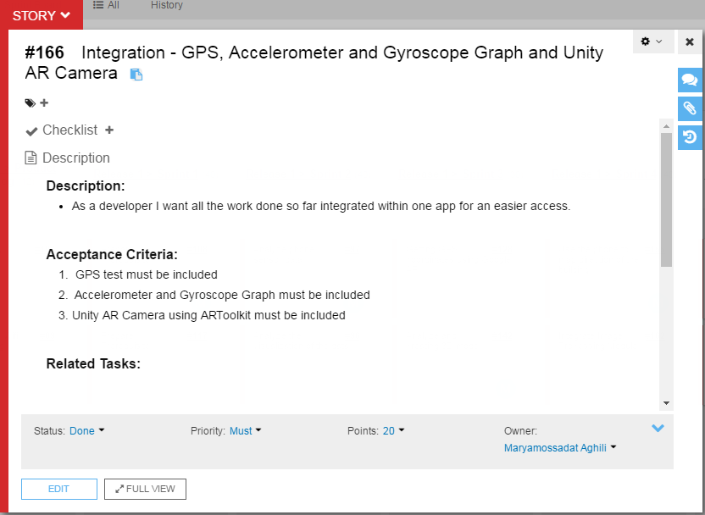
User Story #5
Notes:
20 seconds
The tile of user story
Please present and show the complexity of your work, code, algorithms, and technical challenges and technologies you have used. (you could use screenshot if you want. Visual presentations are better than text presentation) - Go into the details of the most important/significant tasks using bullet lists or visual graphs or state chart diagram - Demo using screenshots or GIF (in another separate page if required)
Sequence Diagram for this user story is optional

Slide 13
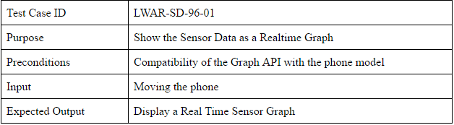
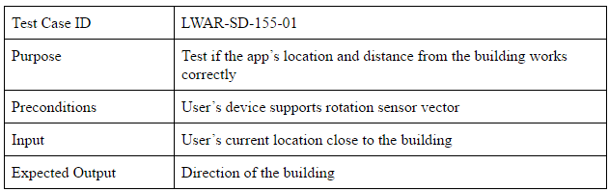
Test Suites and Test Cases
Notes:
10 seconds
A description of verification process and Test Suites and Test Cases for one of the use cases.
1 One sunny day and one rainy day for the implemented use cases (one or more slides).
2 Automated test scripts for the implemented use cases (if any) (one or more slides).

Slide 14





Summary
Considering the research form of the project, we have gone through different approaches for application implementation. Many fields can benefit from the power of Augmented Reality and make the learning experience more fun and engaging.
Contact information
Maryam Aghili: maghi001@fiu.edu
Maria Presa: mpres029@fiu.edu
Questions?
Thank You!
Notes:
10 seconds
Summarize your contribution, mention your effort for Scrum, Mingle, Github, Google Drive Documentation and minutes
Include your contact information
Ask if anyone has any questions for you.
Thank your audience

